Slide 1
Human Resource Analytics Predicting Employee Turnover
Wissam Mohammed
National ICT upskilling program – Data Science

Slide 2
Outline
Human Resource employee turnover (churn)
Dataset
Problem Statement
Methods Exploratory Data Analysis
Methods Machine learning Model
Conclusion
References

Slide 3

Human Resource Is the set of people who make up the workforce of an organization. Employee Turnover (churn)

Slide 4
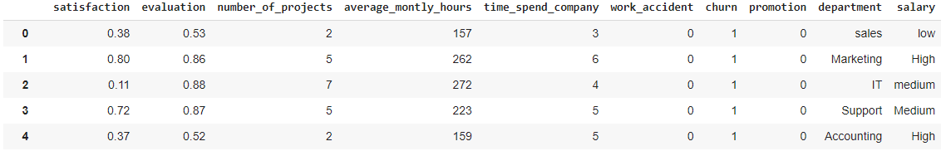

Dataset
14999 Record x 10 Features
Human Resource dataset created by Kaggle community

Slide 5

Problem Statement What is Affecting or causing employee to Turnover ???
Salary
Low satisfaction
Number of Project
Years spent
Work
Accident
Salary

Slide 6
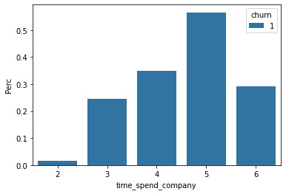


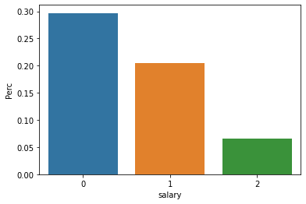
Methods 1. Exploratory Data Analysis
Years
Spent
0 Low salary
1 Medium salary
2 High salary
Salary

Slide 7
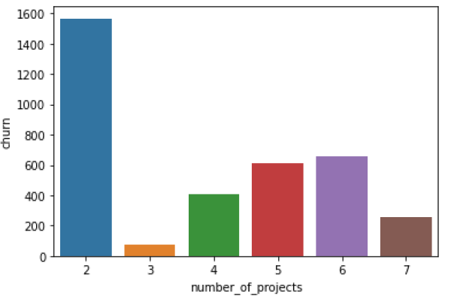
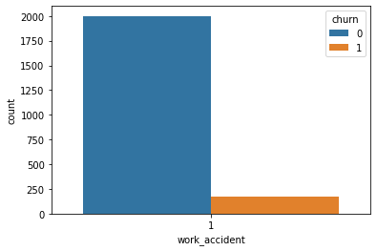
1.1 Exploratory Data Analysis
Number of projects
Work
Accident

Slide 8
1.2 Insights from Exploratory Data Analysis
Left | Percentage | Stayed | Percentage
3571 | 23.80 % | 11428 | 75.19 %

Slide 9
Method 2. Supervised Machine learning Model
Left | Percentage
3571 | 23.80 %
Prove the reasons behind 3571 (Turnover)
Features
Salary
No# of Projects
Years Spend
Work Accident
Low Satisfaction
Supervised
Machine Learning Model
Random Forest Classifier
Decision Tree
Classifier
XGBoost Classifier

Slide 10
2.1 Supervised Machine learning Model Evaluation
Model | Cross Validation Accuracy | AUC Accuracy
Decision Tree Classifier | 95.03 | 94.07
Random Forest Classifier | 95.70 | 93.97
XGBoost Classifier | 96.29 | 96.23

Slide 11
Conclusion
We explored and analyzed human resources dataset
We applied supervised machine learning model algorithm
We had 96.29 confidence accuracy that 23.70 who left is due to the features that we have investigated
Model Evaluation for Ml model (XGBoost had the better performance & accuracy )

Slide 12
References
Human Resource | Kaggle
What Is Employee Turnover (and Why It Matters) | Workest (zenefits.com)
1.10. Decision Trees — scikit-learn 0.24.2 documentation

Slide 13
Thank You

